Slide 1


Faculty of Computing and Informatics
Week 6
Database Design Continued

Slide 2
Recap
The questions to ask:
What are the entities (= objects, individuals) in the organization?
Which relationships exist among the entities?
What information (= attributes) do we want to store about these entities and relationships?
What are the business rules of the organization?
Which integrity constraints do arise from them?
The answers are represented in an Entity Relationship Diagram (ER diagram)

Slide 3
Chen’s Notation
Entity
Attribute
Relationship
Cardinality
Student
StudentNumber
GivenName
Student
enrols
Course

Slide 4
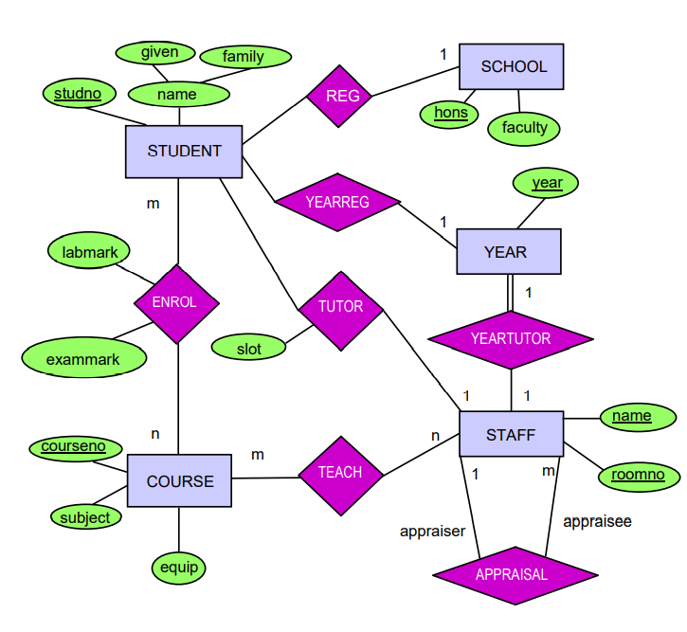
Example OF CHEN’S NOTATION ERD

Slide 5
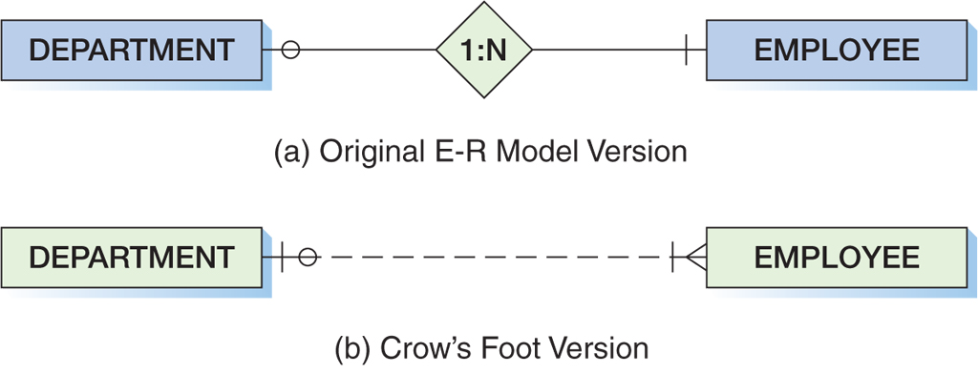
Crow’s Foot Example:
One-to-Many Relationship
Kroenke & Auer (2013)

Slide 6
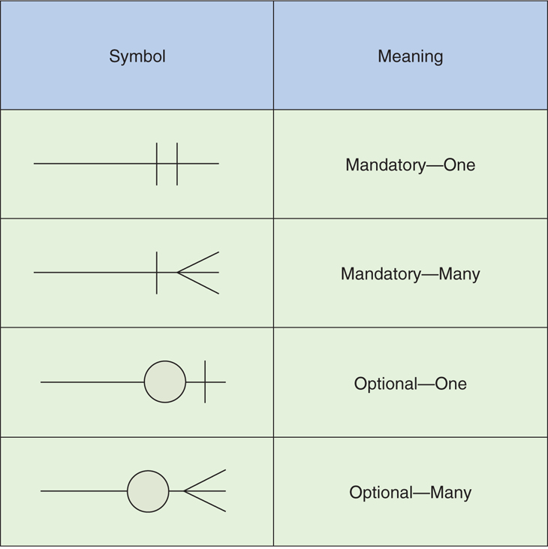
Crow’s Foot Notation
Kroenke & Auer (2013)

Slide 7
Tools for drawing ERDs
You may use the following tools
Microsoft Office Word
draw.io
lucidchart.com
creately.com
smartdraw.com and many more
Standard symbols .

Slide 8
Objectives
At the end of this lesson, students should be able to
Translate the conceptual model into a logical model
Identify and describe anomalies in database designs
Understand the need for normalisation
Define the normalization process up to 3NF

Slide 9
Logical database design
Done after the conceptual design
Logical database design is the process of transforming the conceptual data model into the logical data model. Although there are other data models, we emphasize the relational model for two reasons:
  It is most commonly used in contemporary applications
  The principles of logical database design used for the relational model apply to other logical models as well.
Identify the attributes, cardinalities, determine the primary keys, foreign keys or composite keys
We are learning how to design relational databases, data stored in the form of relations

Slide 10
The Relational Model -
Basic Definitions
The relational model represents data in the form of tables. Only a few simple concepts are needed to describe the relational model. The relational data model consists of the following three components:
1. Data Structure Data are organized in the form of tables with rows and columns.
2. Data Manipulation Powerful operations (using the SQL language) are used to manipulate data stored in relations.
3. Data Integrity Facilities are included to specify business rules that maintain the integrity of data when they are manipulated.

Slide 11
The Relational Model -
Relational Data Structure
Not all tables are relations. The table must meet the following conditions to be a relation:
1. Each relation in a database must have a unique name.
2. An entry at the intersection of each row and column is atomic. There can be no multi-valued attributes in a relation.
3. Each row is unique; no two rows are identical.
4. Each column within a table has a unique name.
5. The sequence of columns is insignificant; the order can be changed without changing the meaning or use of the relation.
6. The sequence of rows is insignificant; the order can be changed without changing the meaning or use of the relation.

Slide 12
Integrity Constraints – Domain Constraints
The relational data model includes several types of constraints whose purpose is to ensure accuracy and integrity of data.
Domain constraints require that all values in a column must be from the same domain. A domain is a set of values defined by domain name, meaning, data type, length and further restrictions (if applicable).
It specifies some of the following characteristics of attributes: data type, length, format, range, allowable values, meaning, uniqueness and null support.
  The use of domains offers several advantages:
  1. Domains verify that the values for an attribute are valid.
  2. Domains ensure the various data manipulation operations are logical.
  3. Domains help conserve effort in describing attribute characteristics.

Slide 13
Integrity Constraints -
Entity Integrity/Null Value
Every relation has a primary key, and the data values in the primary key must be valid ( every primary key attribute must be non null ; this also includes attributes in a composite primary key !). A null value is a value that does not yet exist, or unknown, or not applicable.
A NULL value is an indicator for a particular column in a row, that there is no data value for this particular field in the row (particular attribute can not be assigned a value).
In key columns, a NULL value in any one of them declares the whole key as NULL (if used as a key).
No primary key value can be NULL.
Note that there is only one NULL value for all data types

Slide 14
Integrity Constraints - Referential Integrity/ Foreign Keys
In the relational model, associations between tables are defined through the use of foreign keys
DEF: A foreign key is a column which is used to define a relationship between two tables.
The foreign key is defined on columns which contain data values, which can only be duplicates (or NULL values) of those contained in the primary key of another table.
Therefore, these values associate one or more rows in the table with the foreign key (the “child” table) to a unique row in the table with the primary key (the “parent” table) – unless the foreign key value is NULL, indicating that there is no parent row, i.e. this is an “orphan” row.

Slide 15
Integrity Constraints - Referential Integrity/ Foreign Keys (Cont.)
child
registration
number
frame
number
engine
number
color
type
N100 G
12345
Z9999
red
BMW 3
N 123 W
54321
456 GX 22
white
Nissan
Patrol
N 444 W
77777
100000
white
null
orphan
name
price
imported
from
4x4
BMW 3
140000
Germany
n
Nissan
Patrol
160000
Japan
y
Parent

Slide 16
Mapping ERD to relations
For every entity type create a relation
Every atomic attribute of the entity type becomes a relation attribute
Derived attributes are not included (but remember their derivation rules)
Attributes of the entity key make up the primary key of the relation

Slide 17
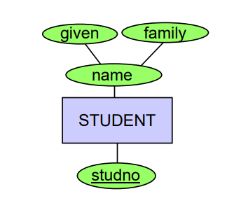
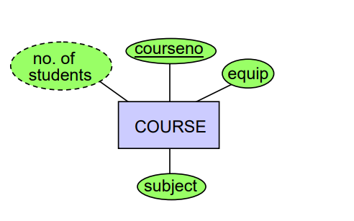
Mapping ERD to relations
enrols

Slide 18
Mapping ERD to relations
Student
GivenName | LastName | studno
Course
Courseno | numofStudents | Euip | subject

Slide 19
Integrity Constraints –
Well-structured relations
A well-structured relation contains a minimum amount of redundancy and allows users to insert, modify and delete the rows in a table without errors or inconsistencies.
Redundancies in tables are called anomalies. There are three types of anomalies:
  Insertion anomaly
  Deletion anomaly
  Modification anomaly

Slide 20
Transforming E-R Diagrams into Relations
In considering this issue, we need to consider how to deal with the following scenarios:
Map Regular Entities
  Composite Attributes
  Multivalued Attributes
Map Weak entities
Map Binary relationships
  Binary one to many
  Binary many to many
  Binary one to one
Map unary relationships
  Unary one to many
  Unary many to many
Map Ternary Relationships

Slide 21
Mapping Regular Entities
Each regular entity is transformed into a relation
The name of the relation is the same as the entity type
Each simple attribute of the entity type becomes an attribute of the relation
The identifier of the entity type becomes the primary key of the corresponding relation

Slide 22
Mapping Multivalued Attributes
Two relations must be created:
  A first relation contains all of the attributes of the entity type, except the multivalued attribute.
  A second relation contains two attributes that form the primary key. The first attribute contains the primary key of the first relation and becomes a foreign key referring to this primary key. The second is the multivalued attribute.

Slide 23
Mapping Multivalued Attributes
EXAMPLE:
E-R Diagram
id
name
EMPLOYEE
skill
Relations (Tables)
EMPLOYEE
EMPLOYEE_SKILL
id
name
id
skill
foreign key reference

Slide 24
Mapping Weak Entities
For each weak entity type, create a new relation an include all of the simple attributes (or simple components of composite attributes).
Include the primary key of the owner relationship.
The primary key of the new relation is a combination of the copied primary key of the owner relation and partial identifier of the weak entity type.
The copied primary key of the new relation is a foreign key referencing to the owner relation.

Slide 25
Mapping Weak Entities
EXAMPLE
E-R Diagram
name
name
has
EMPLOYEE
DEPENDENT
id
dob
Relations (Tables)
EMPLOYEE
DEPENDENT
id
name
id
name
dob
foreign key reference

Slide 26
Mapping One2Many Binary Relationships
One2many relationships are implemented using the back reference from the many side to the one side
CarType
type
Car
1
m
parent
child
foreign key
name
price
imported
from
4x4
registration
number
frame
number
engine
number
color
Name
BMW 3
140000
Germany
n
N100 G
12345
Z9999
red
BMW 3
Nissan
Patrol
160000
Japan
y
N 123 W
54321
456 GX 22
white
Nissan
Patrol
Typical query: select all cars of the type BMW 3

Slide 27
Mapping One2One Binary Relationships
One to one relationships can be considered as special cases of one to many relationships.
If here is an optional side, then the foreign key should be implemented at this side. This avoids storing null values in the foreign key column.
Lecturers
teach
Subjects
0,1
1,1
Lecture # | Name | Surname
1001045 | Samuel | Smiths
101010 | Mary | Van Dick
10147582 | Leo | Martin
Code | Name | Lecture #
IDB112S | Databases | 1001045
PRG100A | Programming | 10147582
PIS112S | Inf. Systems. | 101010
foreign key reference

Slide 28
Mapping Many2Many Binary Relationships
Many2many relationships are implemented using a third association table.
Person
use
Car
m
n
table car_usage
User name
frame_number
De Wyk
12345
name
First_name
registration
number
frame
number
engine
number
De Wyk
Frederik
De Wyk
54321
N100 G
12345
Z9999
Meier
Willi
Meier
54321
N 123 W
54321
456 GX 22
Typical query: select all cars used by Mr. Meyer

Slide 29
Mapping Many2Many Binary Relationships
Sometimes the association tables get a different primary key, e.g. for the following reasons:
1. There is a natural identifier for the association familiar to the end user (like ShipmentID for the shipment relationship between the entity types CUSTOMER and VENDOR). This is sometimes called a surrogate identifier.
2. The copied primary keys are not sufficient to identify relationships. (e.g., there are many shipments between the same customer / vendor), so we may want to add additional attributes (like shipment date).
In both cases, the foreign keys remain despite the modified definition of the primary key in the association table.

Slide 30
Mapping One2Many Unary Relationships
A foreign key is added to the relation that references primary key values in the same relation.
father
E-R Diagram
PERSON
id
name
Relations (Tables)
PERSON
id
name
father_id
foreign key reference

Slide 31
Mapping One2Many Unary Relationships
Node that one2 many relationships are used to model hierarchies (tree structures) !
id
name
father_id
1
Otto
null
Otto
2
Klaus
1
Lutz
Klaus
3
Lutz
1
4
Jens
2
Jens
5
Max
4
5
?
4
Max
?

Slide 32
Mapping Many2Many Unary Relationships
Many to many unary relationships are mapped just like binary many to may relationships except that the both associated tables are actually the same table.
foreign key reference(s)
SIMILARITIES
SKILL
name
description
skill1
skill2

Slide 33
Modeling ternary Relationships
PATIENT
PHYSICIAN
treats
TREATMENT
TREATMENT
id
name
2
XRay
3
Extract Tooth
TREATS
PATIENT
Patient_id
Treatment_id
Physician_id
PHYSICIAN
id
name
1
3
1
id
name
1
Munguni
2
45
1
1
Dax
2
Hangula
3
Witbooi
3
2
3

Slide 34
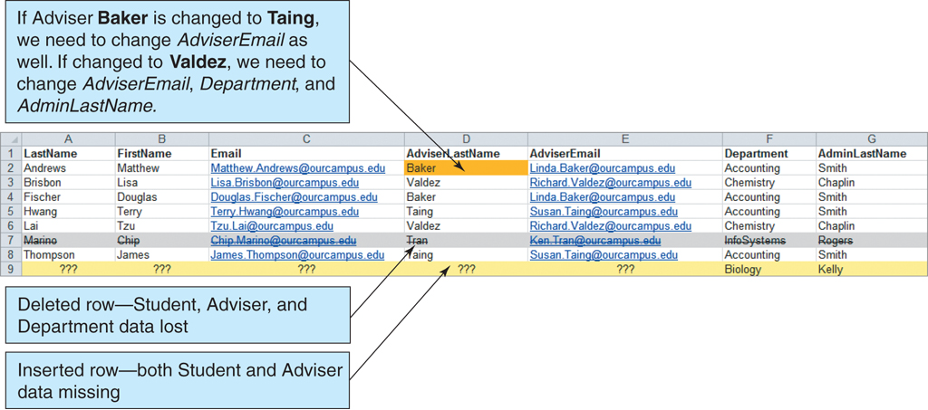
Anomalies

Slide 35
Anomaly 1
Looking at the relation below,
PNumber | PName | PPosition | TeamName | TeamLeague
15 | Zouma | Cback | Chelsea | Premier
4 | Tomori | Cback | Chelsea | Premier
33 | Emerson | Lback | Chelsea | Premier
7 | Kante | Cmid | Chelsea | Premier
10 | Willian | Rwing | Chelsea | Premier
13 | Caballero | Gkeeper | Chelsea | Premier

Slide 36
Insertion anomaly
1. What problems can arise if we have a new player joining the team?
This means we will have player details and no league details
It leaves the League attribute without a value (i.e. NULL), it violates the integrity of the data
This is called an insertion anomaly.
Similarly recording a new student data without the adviser details is an example of insertion anomaly.

Slide 37
Deletion Anomaly
2. What problem arises is when we delete the Team details from the table?
We will also delete the player details in the affected rows
This is an example of a deletion anomaly where some data is lost as we delete the other data.

Slide 38
Update Anomaly
3. What problem arises if the Team registers in a new League e.g. MTC
If we forget to update one record with the new League name
We have to update multiple rows with the same value since the data is repeated in several rows (redundant).
If other rows are left without an update, that is an anomaly
This is an example of an update anomaly.

Slide 39
Solving Anomalies
The anomalies described may be resolved by the process called normalization
Normalisation aims to:
1. To eliminate redundant data
2. Ensure data dependencies make sense

Slide 40
DEFINITION- Normalisation
Normalization theory is the study of relations (tables), attributes (columns), and the dependency of attributes upon one another.
Process of organising data in database.
Create tables and establish relationships between those tables according to the normalisation rules
Systematic approach of decomposing tables to eliminate data redundancy process where data is put into a table by removing duplicated data from relation tables

Slide 41
Functional Dependency
Functional dependency (FD) is a set of constraints between two attributes in a relation.
Functional dependency says that if two tuples have same values for attributes A1, A2,..., An, then
those two tuples must have to have same values for attributes B1, B2, ..., Bn.
Functional dependency is represented by an arrow sign (→) that is, X→Y, where X functionally determines Y.
The left-hand side attributes determine the values of attributes on the right-hand side.

Slide 42
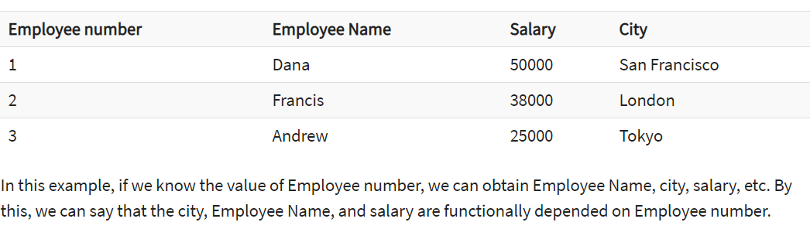
Functional dependency
Extracted from tutorialpoint

Slide 43
REASONS FOR NORMALISATION
The reasons are to avoid cases where
To update a column for a record which occurs twice or more in a table. We have to update all rows to avoid inconsistency
Avoid having columns with NULL values as it is an anomaly
To delete a value in a column may lead to deleting entire record. Avoid inconsistent dependencies.

Slide 44
1NF
No 2 rows of data must contain repeating group information, Each row should be uniquely identified
Each set of column must have a unique value, Each cell allows a single value
Multiple columns can’t be used to fetch the same row,
Allows only atomic values
  Values in a column are of the same category
NB: a table must not take more than one value for a column
If so, separate the data into multiple rows
Create separate table for each set of related data

Slide 45
1NF
Rules for First Normal Form
Allow only atomic values
  Each cell allows a single value
  Values in a column are of the same category
  Each row should be uniquely identified

Slide 46
Normalization Rule 1
A table is in First Normal Form (1NF) if all of it’s column contain atomic values.
The first property of a relation is that the value at the intersection of each row and column must be atomic.
Are the following tables in 1NF ?
name
children
name
father
Jens
Max
Max
Jens
Ulf
Lars, Thomas
Lars
Ulf
no
yes

Slide 47
2NF
Rules for Second Normal Form
  Requirements for First Normal Form met
  All attributes dependent on the primary key
  Any attribute that does not depend on the primary key should be moved to another table
  No partial functional dependencies

Slide 48
2NF
The table must be in 1NF
Non key attributes should be functionally dependent on the primary key.
Create a separate table for sets of values that apply to multiple records
Relate tables with a foreign key
Split table to remove the column causing redundancy and make it into another table.

Slide 49
Normalization Rule 2
A table is in Second Normal Form (2NF) if :
1. It is in 1NF and
2. All of its attributes are fully functionally dependent on the primary key only.
Is the following table in 2NF ?
registration
number
frame
number
engine
number
color
type
price
N100 G
12345
Z9999
red
BMW 3
140000
N 123 W
54321
456 GX 22
white
Nissan
Patrol
160000
No, since the price depends on the type, not on the reg. Number !

Slide 50
3NF
Every non-key attribute of table must be dependent on primary key
No case of a non-key attribute is determined by another non-key attribute.
Table must satisfy 2NF rules
Eliminate fields that do not depend on the key
If contents of a group of fields apply to more than a single record in the table, then those fields must be in a separate table.

Slide 51
Achieving 2NF
registration
number
frame
number
engine
number
color
type
price
2NF can avoid inconsistencies.
N100 G
12345
Z9999
red
BMW 3
140000
N 123 W
54321
456 GX 22
whi
Nissan
Patrol
160000
N 23 G
54325
456 GX 23
blue
Nissan
Patrol
160000
2NF can be achieved by splitting tables.
registration
number
frame
number
engine
number
color
type
type
price
foreign key
relationship
N100 G
12345
Z9999
red
BMW 3
BMW 3
140000
N 123 W
54321
456 GX 22
whi
Nissan
Patrol
Nissan
Patrol
160000
N 23 G
54325
456 GX 23
blue
Nissan
Patrol

Slide 52
Normalization Rule 3
A table is in Third Normal Form (3NF) if it is in 2NF and all of it’s columns depend entirely on the primary key only.
Is the following table in 3NF ?
Course ID
Department
ID
Course
Name
Department
name
2
1
history of
economics
management
3
2
databases
information
systems
1
2
software
engineering
information
systems
No, since department name depends only on department id, not on the course id. The solution to achieve 3NF is again splitting the table.

Slide 53
Lets Normalise !!!
StudentName | Age | Course
Peter | 21 | DBF, DSA
Susan | 25 | JAV
John | 35 | BMC

Slide 54
1NF
StudentName | Age | Course
Peter | 21 | DBF
Susan | 25 | JAV
John | 35 | BMC
Peter | 21 | DSA

Slide 55
2NF, 3NF
StudentName | Age
Peter | 21
Susan | 25
John | 35

Slide 56
2NF, 3NF
StudentName | Course
Peter | DBF
Susan | JAV
John | BMC
Peter | DSA

Slide 57
3NF Consider this relation
Student ID | StudentName | Age | City | RegionCode
2120 | Popey | 23 | Windhoek | 061
2201 | Ruby | 19 | Windhoek | 061
3012 | Pinky | 34 | Goababis | 062

Slide 58
3NF
Student
Student ID | StudentName | Age
2120 | Popey | 23
2201 | Ruby | 19
3012 | Pinky | 34
Address
City | RegionCode
Windhoek | 061
Goababis | 062

Slide 59
Summary
In this lesson, we focused on
Logical design
Insert, update and delete anomalies
Introduction to normalisation

Slide 60
References
Kroenke, D. M. & Auer, D. (2018). Database concepts (9th ed.), Pearson
Tutorial point . DBMS Normalisation [online] available at https://www.tutorialspoint.com/dbms/database_normalization.htm.

Slide 61
Next lecture
Understand business rules
Describe various constraints in relational databases
Map a logical data model to a physical data model
Present a physical schema for implementation

